Slide 1




Slide 2
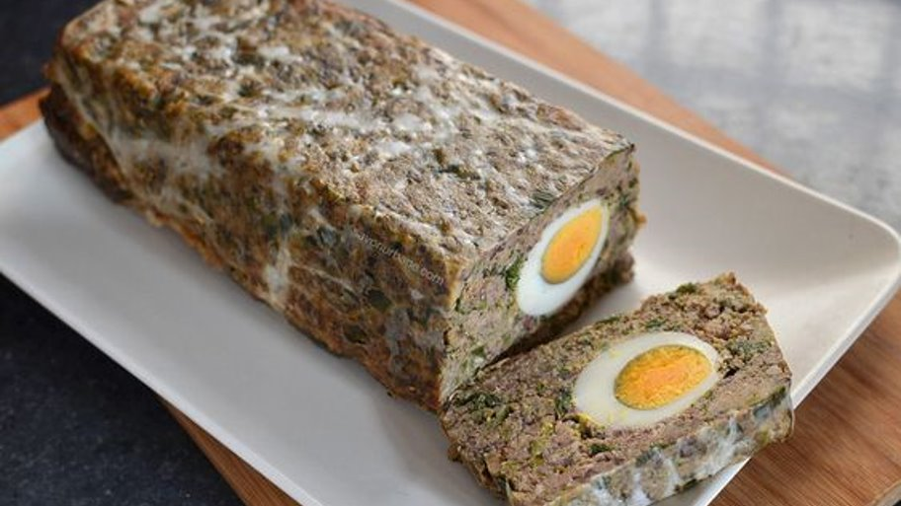
DROB DE MIEL
-LAMB TRIPE

Slide 3










Ingredients:​​
a)
b)
c)
a) organs of lamb (liver, lungs, heart, kidneys)​
b) 4 bundles of chopped onion​
c) 4 bundles of chopped garlic​
d) 2 dill bindings
e) 2 bundles of parsley
f) 6 raw eggs​
g) 3-5 boiled eggs​
h) 4 tablespoons oil​
i) a little pepper​
j) a little salt​
h)
d)
j)
e)
i)
g)
f)

Slide 4





Method of preparation:​
1. Put the lamb organs to boil for 30-40 minutes.​
2. Meanwhile, temper the onion and garlic with a little salt for 10 minutes.
3. After the organs have boiled we cut them.

Slide 5
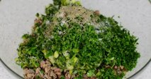
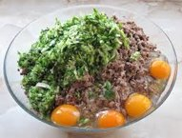
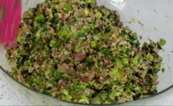
4. We mix the organs with the other ingredients and garlic and onion until we form a homogenous mixture.

Slide 6
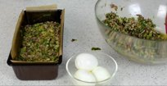
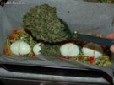
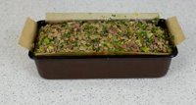
5. We put half the mixture in the tray.
Over which we put boiled eggs and the rest of the mixture.
6. Finally we put the tray in the oven for 30-40 minutes.

Slide 7
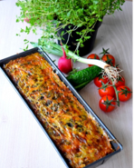
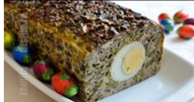
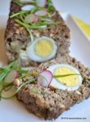

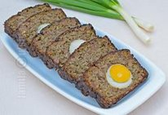
Drobul -Lamb tripe is ready.
You got 10-12 servings.

Slide 8
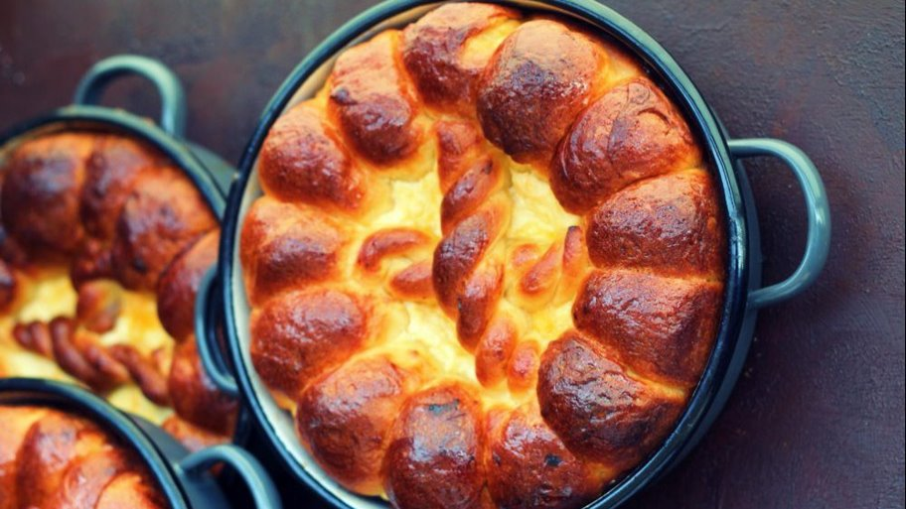
PASCĂ

Slide 9








Ingredients:
a)
b)
1. For the dough:
a) 500 grams of flour
b) 120 grams of sugar
c) 250 mililiters of milk
d) 50 grams of butter+50 grams of oil
e) 2 yolks
f) 1 lemon peel
g) 10 grams of dry yeast
25 grams of fresh yeast
h) 1 pinch of salt
h)
c)
g)
d)
f)
e)

Slide 10


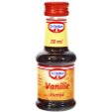


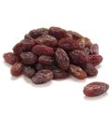


a)
b)
2. For the cream:
a) 400 grams of sweet cottage cheese
b) 2 eggs
c) 2 tablespoons sugar
d)100 grams of raisins
e) 3 tablespoons semolina
f) 1 lemon peel
g) 2 sachets of vanilla sugar
h) 1 vanilla essence
h)
c)
g)
d)
f)
e)

Slide 11



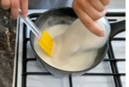
Method of preparation:​
a. For the dough:
1. The first thing we do is make ''maiaua'' (a kind of yeast) for the dough.
It consists of a little yeast, sugar, flour and milk.
Then let it rise for 10-15 minutes.
2. Meanwhile dissolve the sugar in lukewarm milk.

Slide 12

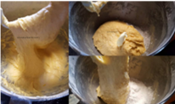
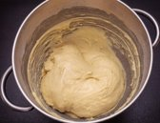
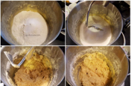
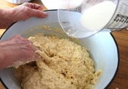
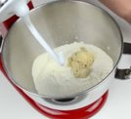
3. Then put in a bowl flour and ''maiaua'' (a kind of yeast)and the rest of the ingredients and mix.
Gradually add the sugar dissolved in the milk until we get a sticky dough which we will let rise for 1 hour.

Slide 13
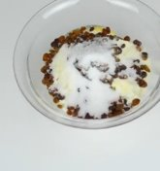
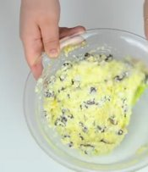
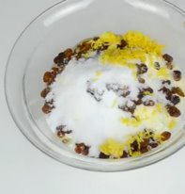
b. For the cream:
4. While the dough rises we take care of the cream.
This is very easy to do..mix all the ingredients for the cream.

Slide 14
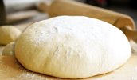
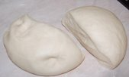
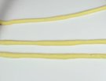


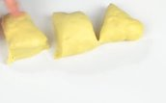
5. After the dough has risen, divide it into two pieces.
6. With one piece we make a braid and we put the other on the bottom of the tray.

Slide 15
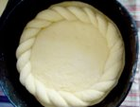
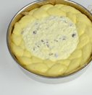
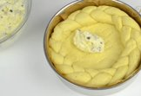
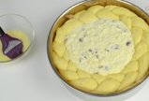
7. Then we put the braid over the dough in the tray.
8. Now we put the cream in the middle and grease it with egg.
9. And now we put it in the oven for 40-50 minutes.

Slide 16
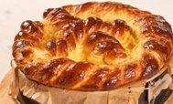
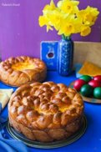
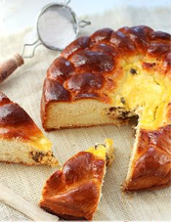
Pasca is ready.

Slide 17
The European Commission's support for the production of this publication does not constitute an endorsement of the contents, which reflect the views only of the authors, and the Commission cannot be held responsible for any use which may be made of the information contained therein.

