Slide 1
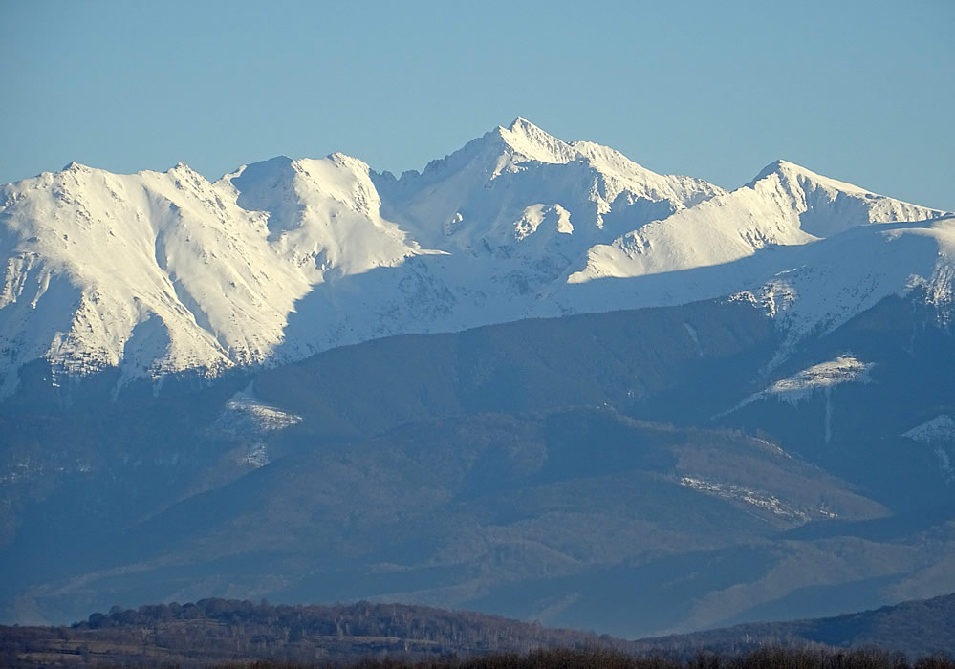
THE FĂGĂRAȘ MOUNTAINS

Slide 2
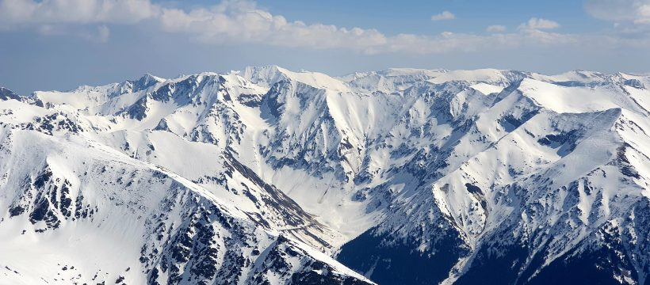
They represents the largest alpine unit in Romania, known for the wildness with which it outlines its landscapes and the numerous natural treasures that make any tourist discover the joy of the mountain.

Slide 3
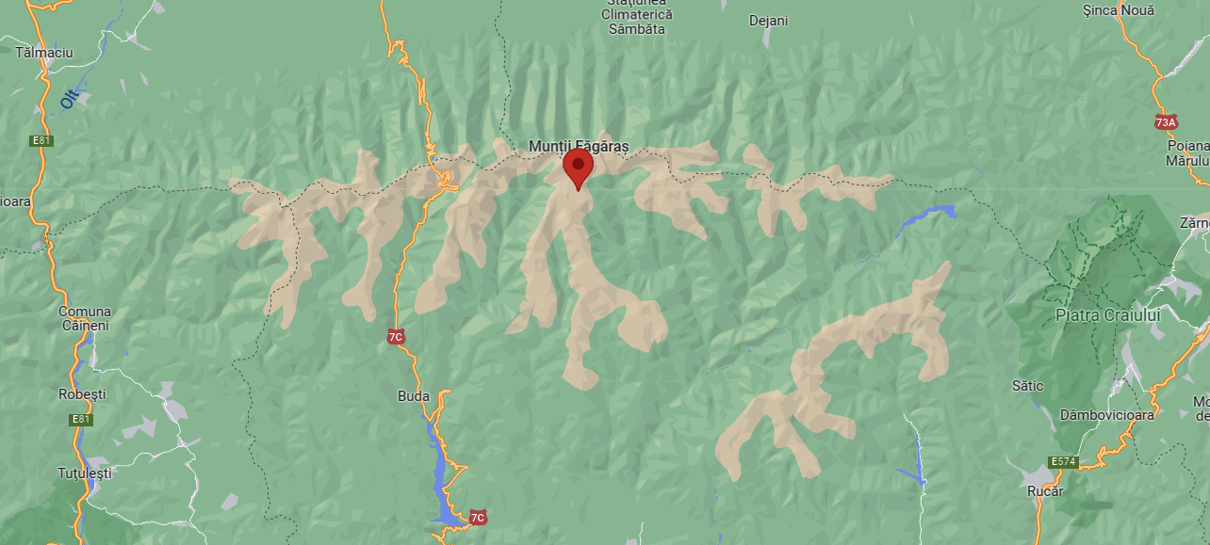
Geographical location: in the Southern Carpathians, to the E-V having a length of 70 km; it is bordered on the west by the Olt Defile, on the east by the Piatra Craiului Mountains, on the north by the Transylvanian Plateau, and on the south by the Loviștei Corridor.

Slide 4
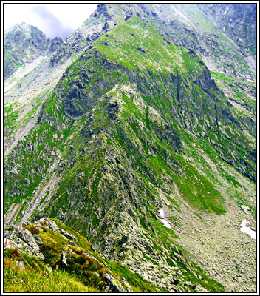
resemble a huge spine with steeper “ribs” facing north and slower southern ones
the density of peaks and cliffs make us call them The Transylvanian Alps

Slide 5
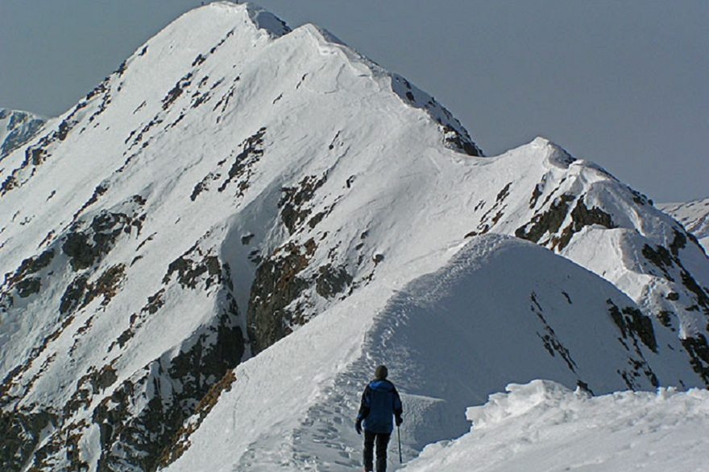
There are 8 peaks of over 2.500 m in the Făgăraș mountains, the highest being Moldoveanu with 2.544 m
Pe cuprinsul întinderii masivului Făgăraș se găsesc 8 vârfuri de peste 2.500 de metri, cei mai înalți fiind: Moldoveanu cu 2.544 m și Negoiu cu 2.535 m.

Slide 6
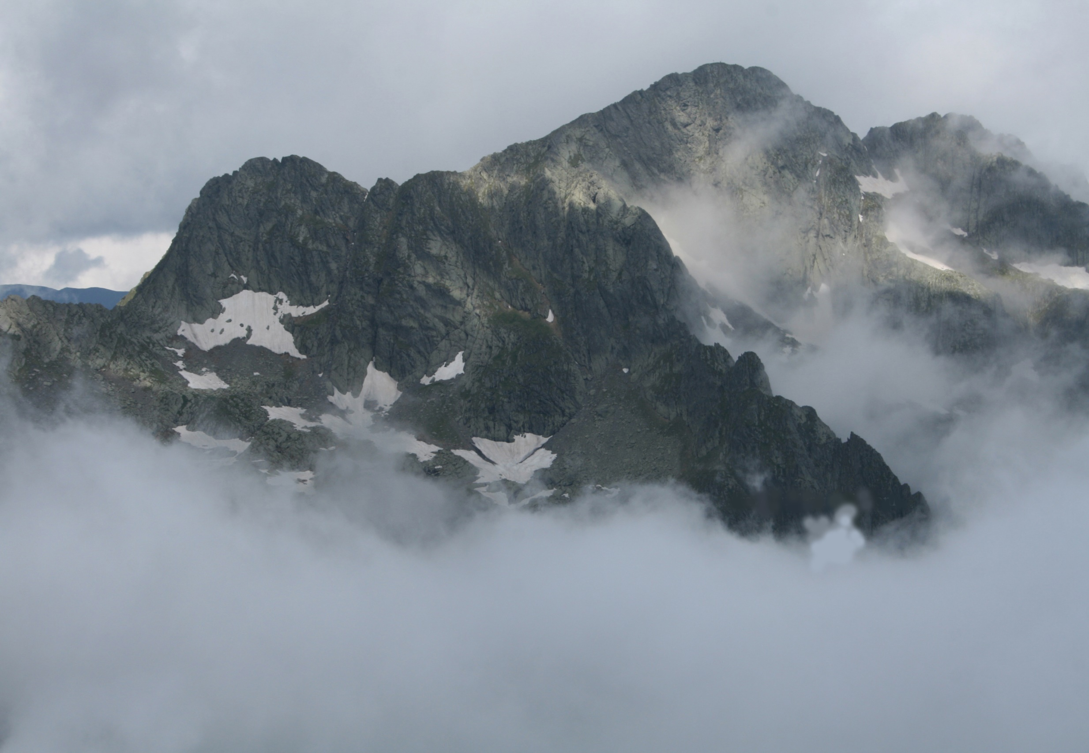
harsh weather, rare days when the sky is completely clear
The highest precipitation values
the most frequent avalanches in the country

Slide 7
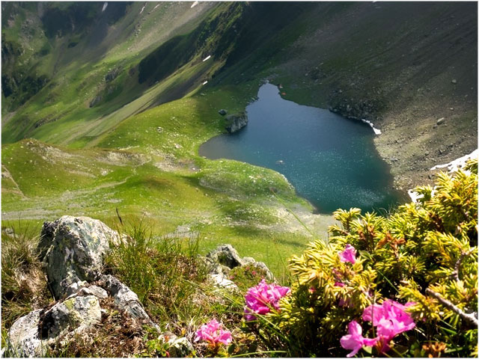
The glacial area presents circuses or glacial cauldrons with lakes that are chained on the main peak, offering tourists places with wonderful landscapes to stop.
The water is good to drink, being clean water, with an amazing transparency.

Slide 8
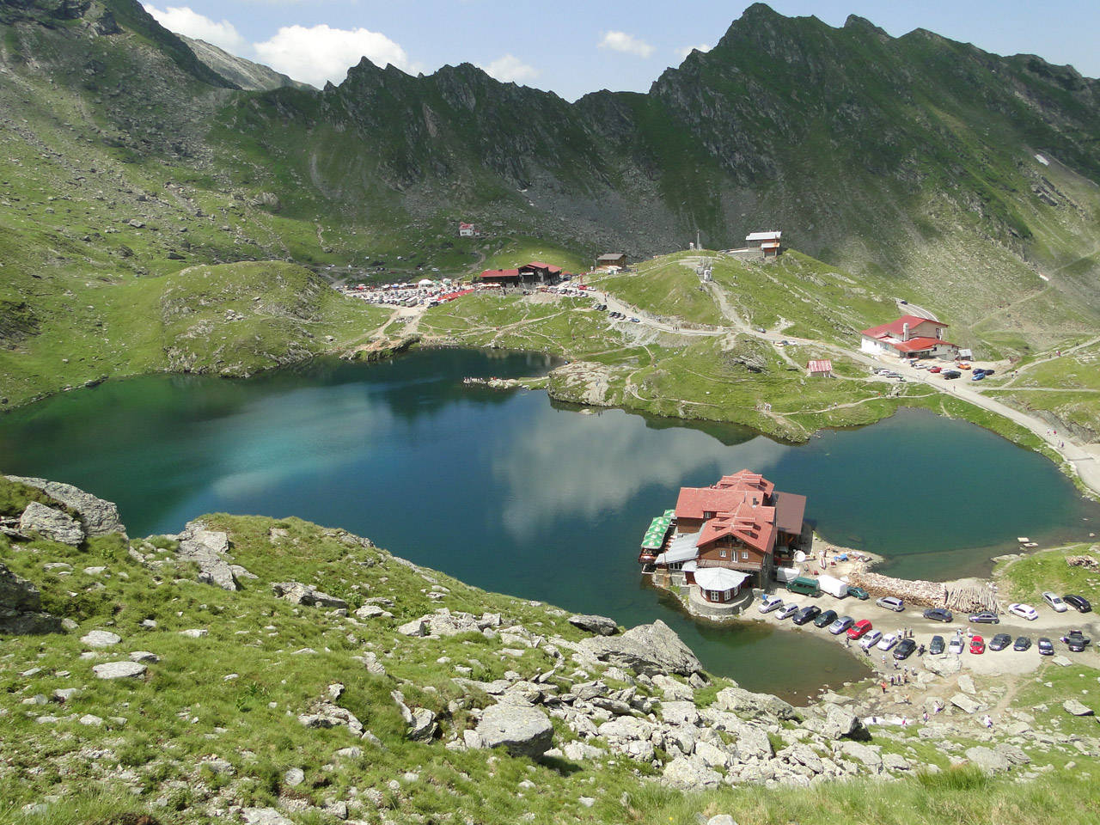
Bâlea Lake - the beauty in the heart of the Făgăraş Mountains
one of the largest glacial lakes
located at an altitude of 2040 m
about 11 m deep

Slide 9
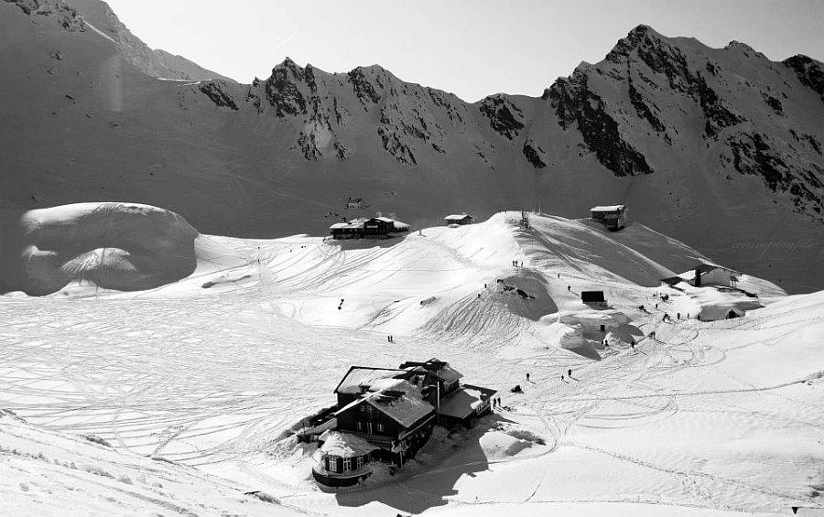
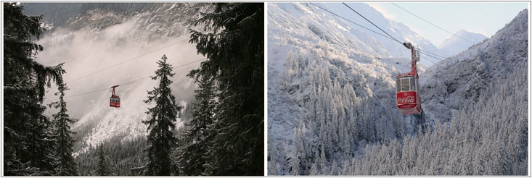
in winter, Bâlea Lake can be reached by cable car from the “Bâlea Cascadă’’cottage

Slide 10
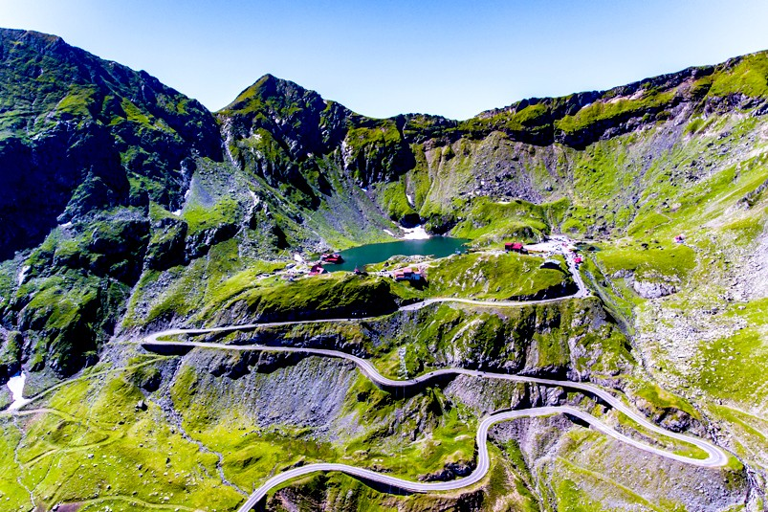
in summer, the access to Bâlea Lake is made on TRANSFĂGĂRĂȘAN,
one of the most spectacular roads in Europe, built between 1970 and 1974

Slide 11
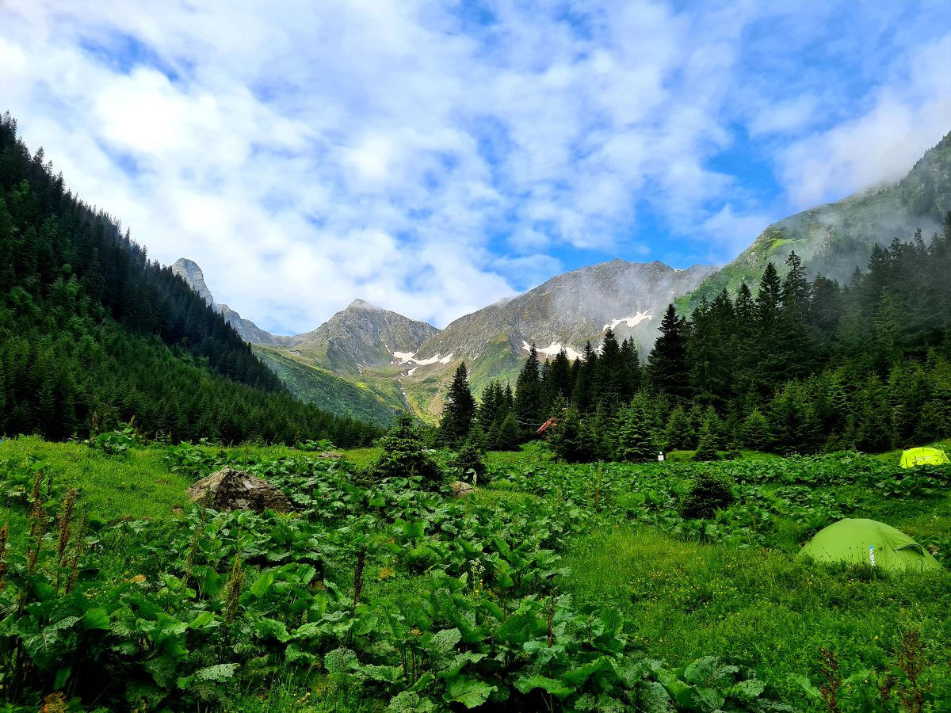
The vegetal clothing of the Făgăraș Mountains is very rich and varied.
The vegetation differs in altitude, forming distinct areas and layers.

Slide 12
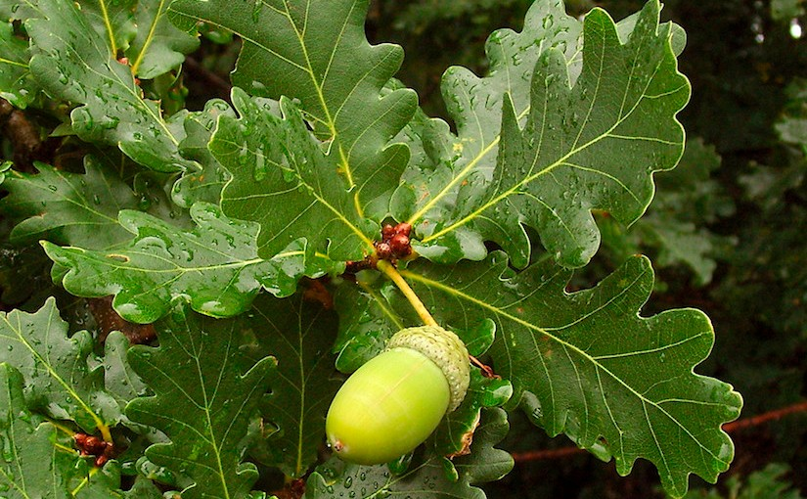
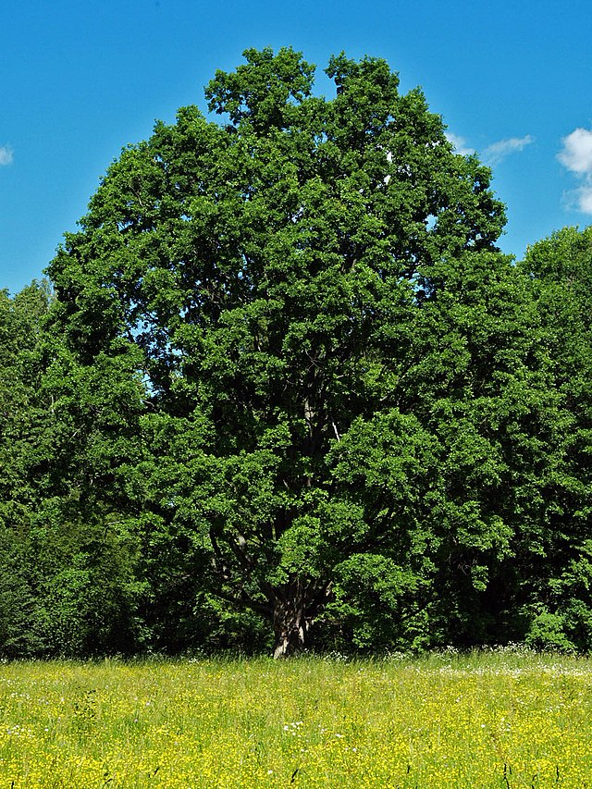
at the foot of the mountains there is the oak forest layer (Quercus robur), with lobed leaves and acorn-like fruit, eaten with pleasure by wild pigs
the wood of the tree is precious, used in construction and the production of luxury furniture.

Slide 13
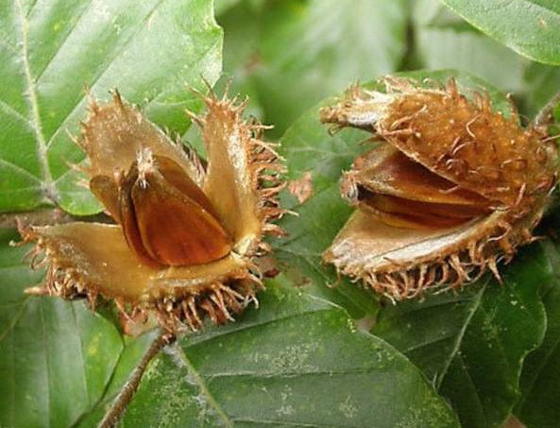
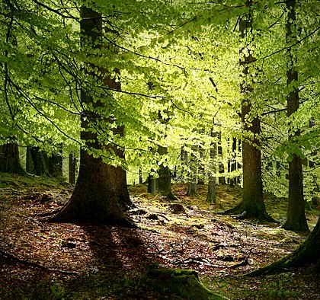
the beech forest begins above(Fagus sylvatica) making up the truly great forests
beech, the fruit of the beech tree, has been used since ancient times for a certain type of oil and for pig feed.

Slide 14
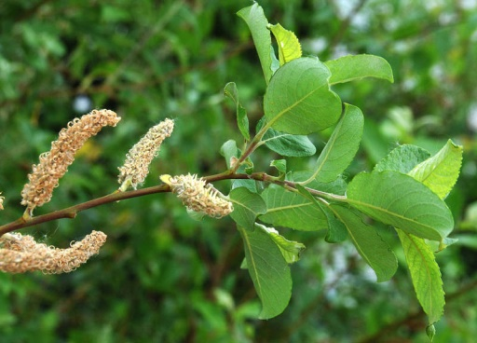
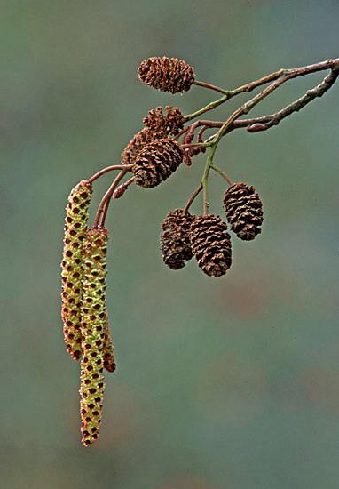
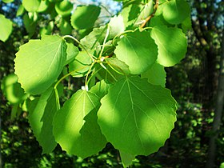
In the clearings of the beech forests, as well as on the shores of the waters we encounter:
The Brown willow
(Salix caprea)
Its bark contains a substance used to prepare aspirin
The black alder
(Alnus glutinosa)
The trembling poplar
(Populus tremula)
its leaves tremble at the slightest breeze
Its bark contains a substance used at dyeing

Slide 15
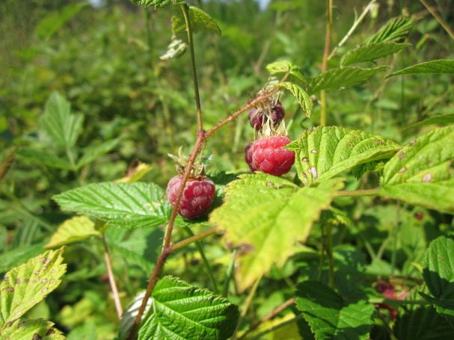
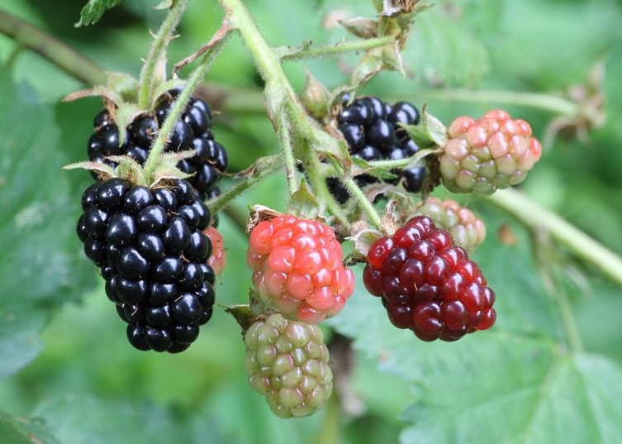
The Raspberry (Rubus idaeus)
xylitol is extracted from it, an artificial sweetener used mainly in the treatment and prevention of dental cavities
The Blackberry (Rubus fruticosus)
the fruit is eaten fresh or cooked

Slide 16
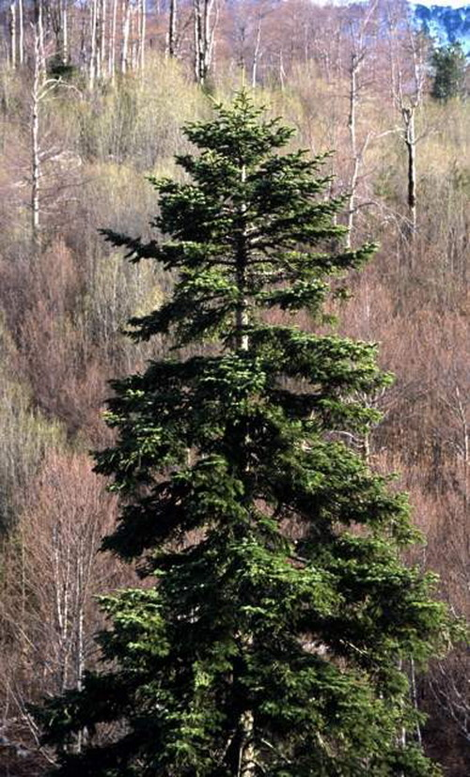
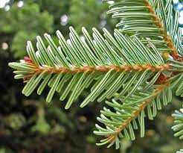
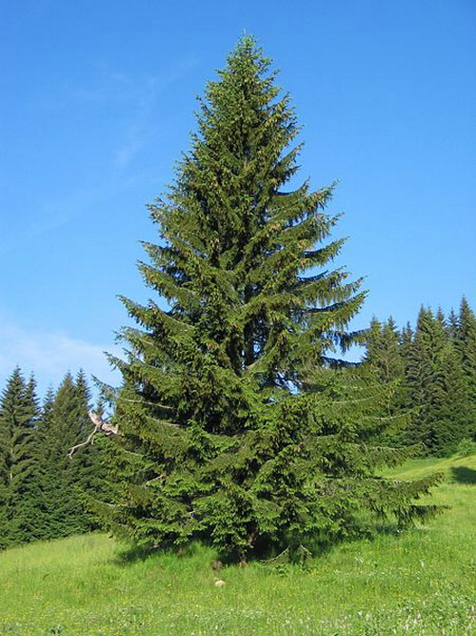
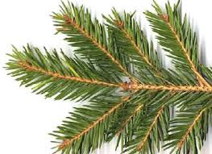
At the top of the forest, the beech trees
mix with the fir trees (Abies), which appear pretty rare.
Needle-shaped, oval
leaves at the top, with
2 white bands
below
Instead, their place is taken by the spruce trees (Picea abies), which occupy the entire forest region, up to almost 1.700 m altitude.
Completely green needle-shaped leaves with a tip
sharp, stinging

Slide 17
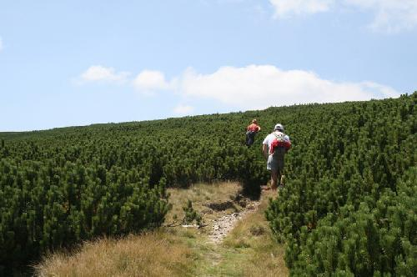
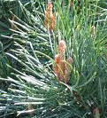
Other resinous trees from Făgăraș:
Pinul (Pinus) / The Pine
long leaves, grouped in bundles
Jneapănul (Pinus mugo)
the stem has a greater horizontal development, it is a system of defense against avalanches

Slide 18
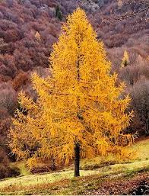
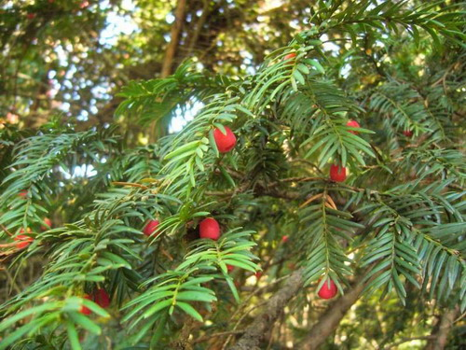
Zada or laricele ( Larch)
(Larix decidua)
The only conifer with
falling leaves
Tisa (Taxus baccata)
Its flowers are in the form of red and fleshy berries
wooden bows and arrows have been made of wood since ancient times
It is protected by law

Slide 19
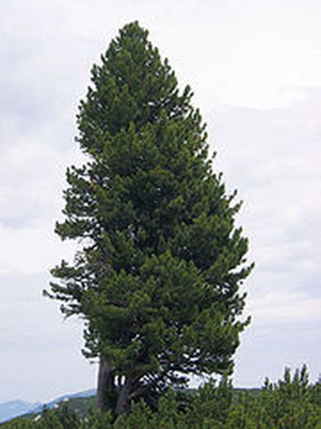
Zâmbrul (Pinus cembra)
rare specimens
slow growth
lives over 1000 years
protected by law

Slide 20
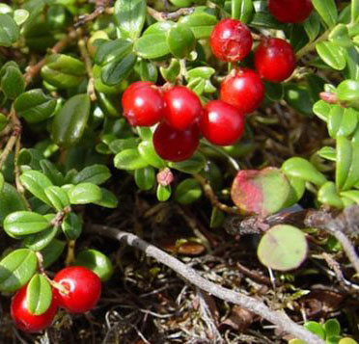
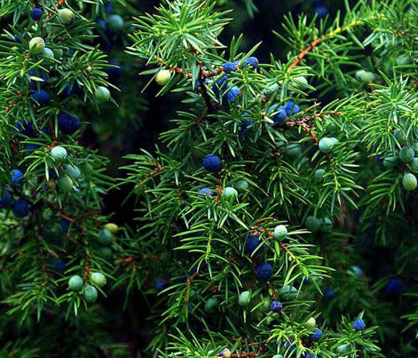
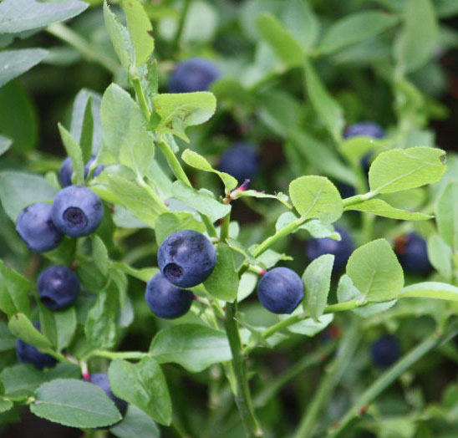
From the upper limit of the forests up to 2200 m altitude jnepen bushes are accompanied by:
Ienupăr –
The Juniper
(Juniperus sp.)
produces black-blue fruit
used for medical purposes, cabbage spicing, flavoring for spirits
The Bilberry (Vaccinium
myrtillus)
natural antibiotic used in the treatment of diabetes
The Cranberry
(Vaccinium vitis-idaea)
used for kidney problems

Slide 21
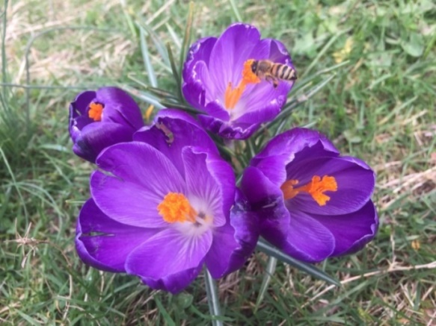
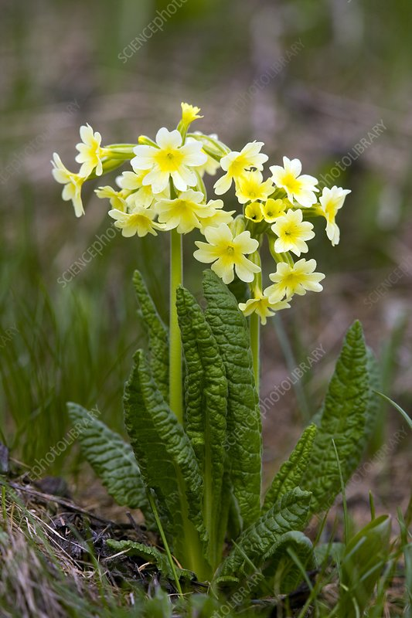
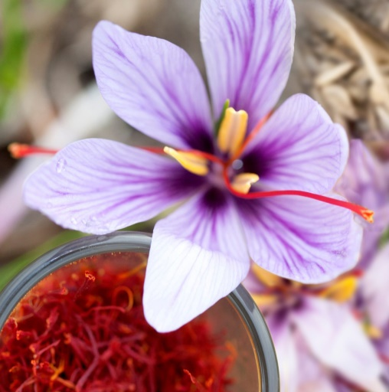
The green carpet of the alpine layer is formed by:
The Spring Crocus (Crocus vernus)
plant related to Crocus sativus,originating inGreece, cultivated for about 3000 years
saffron is obtain from it
Saffron - the most expensive spice in t the world (30.000-40.000 euros / kg)
obtained from flower stigmas
Ciuboțica cucului/The Primrose
(Primula elatior)
medicinal plant
useful in cough treatment

Slide 22
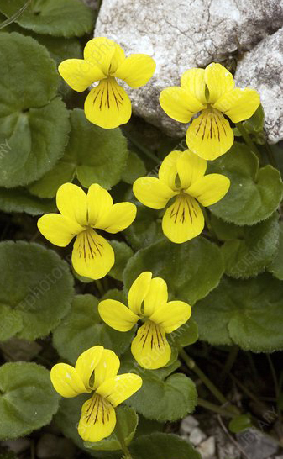
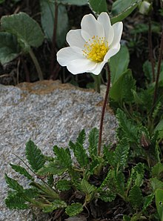
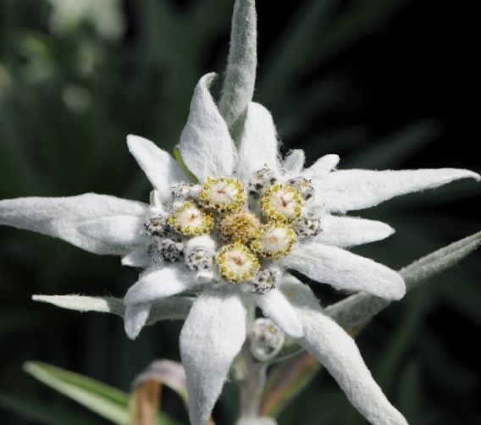
On limestone bloom:
Argințica/ The Silver Plant
(Dryas octopetala)
woody small plant
with 8 petals
The Edelweiss
(Leonthopodium
alpinum)
the rarest perennial plant in the mountain flora
protected by law,
a symbol of modesty and endurance
The Yellow axes
(Viola biflora)
with 4 raised petals
up and one
pointing down

Slide 23
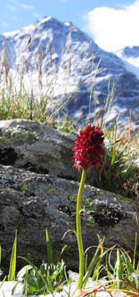
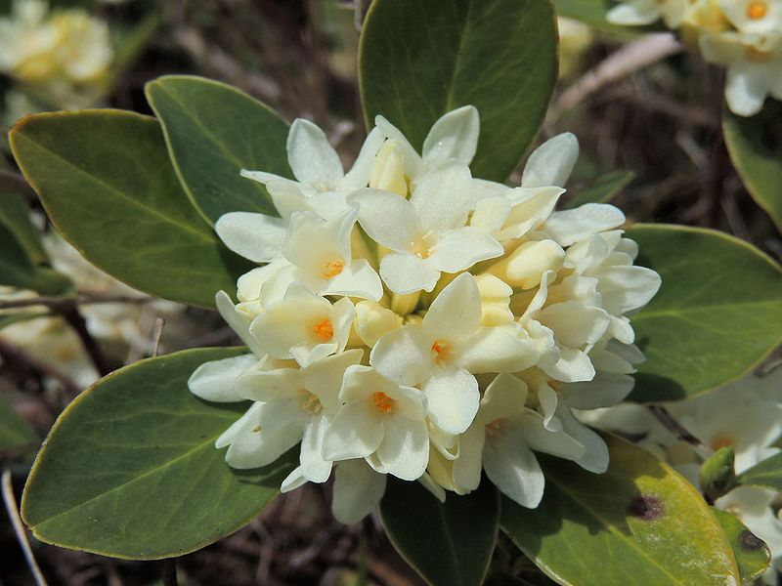
Other species of herbaceous plants protected by law are:
Sângele voinicului
(Nigritella rubra)
The blood of the young/
brave
man
orchids with purple red
flowers,
vanilla scent
The White Ivy
(Daphne blagayana)
spring flowering shrub,
nice smell

Slide 24
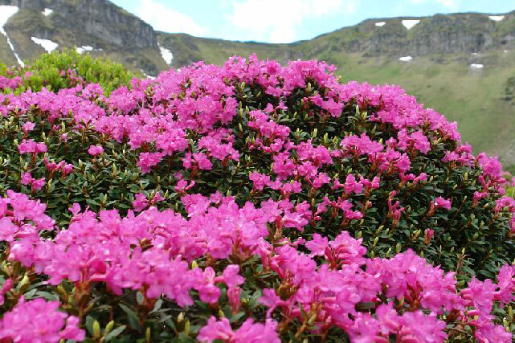
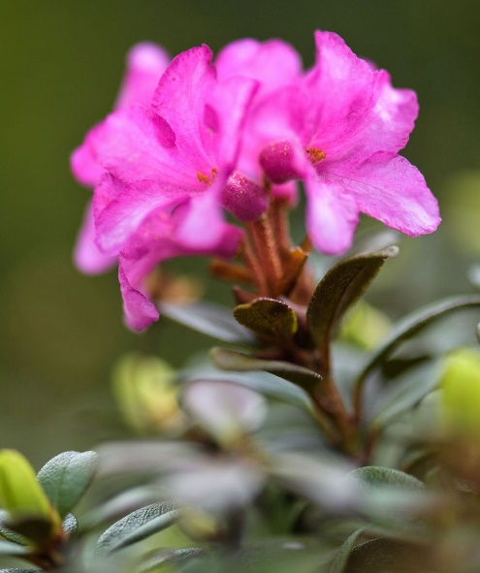
one of the great ornaments of Făgăraș is the mountain peony (Rhododendron kotschyii)
protected plant that blooms in June-July
syrup, jam and
medicinal teas used
to be made of it

Slide 25
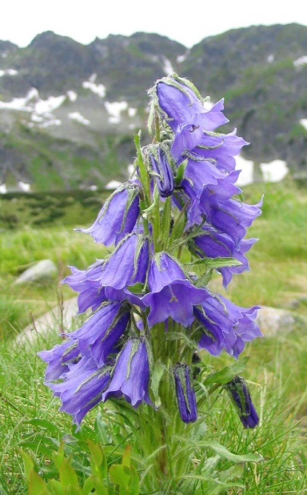
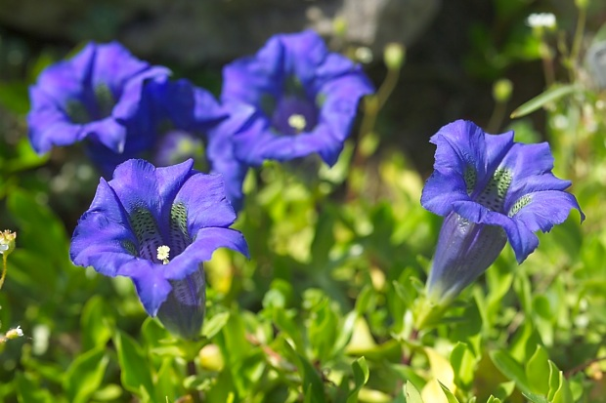
In the harshest conditions of the upper alpine layer (beyond 2200 m) grow delicate flowers of:
Clopoțel de munte/ The Mountain bell (Campanula alpina)
bell-like flowers
Gențiana/ The Gentian
(Gentiana acaulis)
Medicinal plant, liqueurs and bitter are prepared from the roots

Slide 26
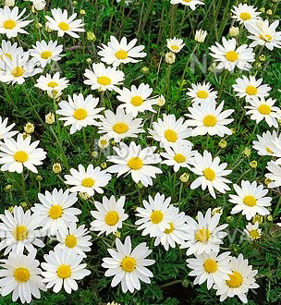
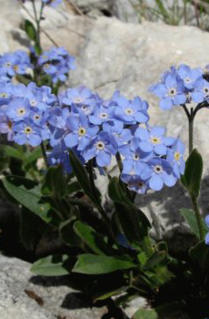
Nu-mă-uita
(Myosotis alpestris)
The Forget –me- not flower
-medicineal plant, used in eye and ear diseases
Romaniță-de-munte
(Anthemis carpatica)

Slide 27
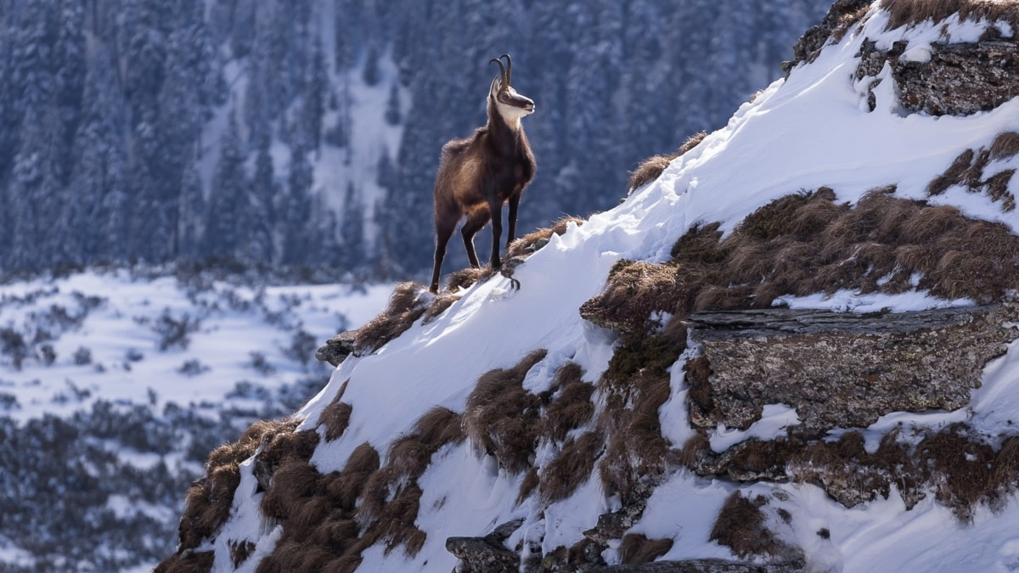
FAUNA:
alpine heights are the kingdom of black goats (Rupicapra rupicapra)
protected species by law
The Făgăraș mountains are home to the largest number of black goats in Romania

Slide 28
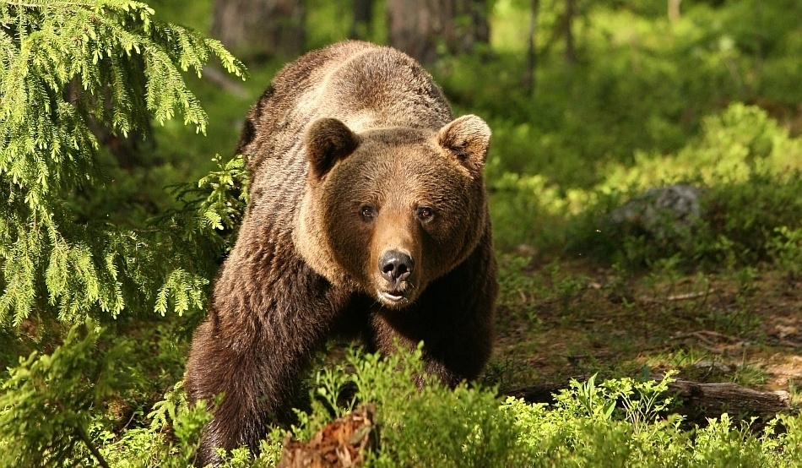
The brown bear (Ursus arctos): protected by law, it maintains its shelters at the upper limit of coniferous forests
a large part of the brown bears of Europe - about 6000 specimens - live on the Romanian territory
It can even hear us from300 meters!
It can detect the presence of any animal, even 14 hours after its crossing through an area!
It can run very fast
( 50 km per hour)

Slide 29
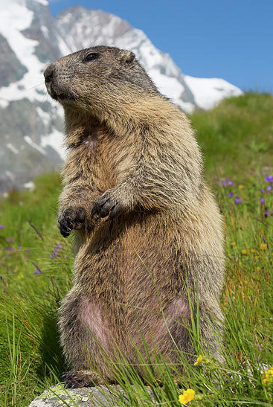
Marmota/ The marmot
(Marmota marmota)
Funny, endangered animal
lives in groups
it digs its lair under the rocks;
in case of danger, it makes a
sound like a bird's howl
In winter it hibernates and
its body temperature
drops to 4-5 degrees Celsius

Slide 30


Râsul (Lynx lynx)
extended by one
tuft of black hairs
predator par excellence
waits for its victims on rocks or
in trees and throws at him
They are less common:
Jderul (Martes martes)
nocturnal carnivorous mammal
hunted for its valuable fur

Slide 31


The Squirrel (Sciurus vulgaris) appears everywhere on the hiking trail, in forest areas
The Fox (Vulpes vulpes)
once considered a "chicken-eater", it has been cruelly hunted
It spreads - especially in rural areas - very serious diseases, including rabies

Slide 32


The charm of the forests at the foot of the mountains is given by:
The stag (Cervus elaphus)
The male has horns richly branched
The Deer (Capreolus capreolus)
the male has small horns
the female has no horns

Slide 33


The wolf (Canis lupus)
lives in families or packs
communicates through body language and facial expressions
the hunting instinct is automatically activated by fleeing animals. Therefore, in an attack on a sheepfold, wolves will kill more animals than they can eat.
The Wild boar (Sus scrofa)
a precious game
attacks the man only if it is injured or to protect its cubs

Slide 34



Many birds beautify the life of the forest. Here we can see:
The woodpecker
(Dendrocopos sp.)
in search of insects hits the bark of trees with its beak (over 40 beats per second)
The Blackbird
(Turdus merula)
the male's song is associated with the coming of spring
Codobatura de munte/The Mountain cod
(Motacilla cinerea)
it constantly swings its long tail, which causes its entire hindquarters to move

Slide 35



Cinteza (Fringilla
coelebs)
the male, brightly colored, attracts the female's attention by its noisy chirping
Sturzul
(Turdus pilaris)/ The Trush
It attacks prey "Bombing them"with excrement!
Forfecuța / The little scissors
(Loxia
curvirostra)
strong beak, with the tips of the jaws crossed like scissors, a perfect fit to remove the seeds from the cones

Slide 36


:
Ierunca /The Grouse
(Tetrastes bonasia)
the female rises from the nest only when danger is imminent
simulates the wound by lowering its wing to draw the enemy after it, then returns in a crouched flight to the nest
Through the thickets we encounter:
Cocoșul de munte / The mountain rooster
(Tetrao urogalus)
the male catches the female's attention through the bridal dance in which it opens its feathers in the shape of a fan and emits specific sounds

Slide 37


The birds of prey that live here are:
Șoimul (Falco sp.)
excellent eyesight
particularly sensitive to pesticides in food
can fly very fast( 380 km / h)
Uliul (Accipiter
gentilis)
sedentary species
hunts many rodents

Slide 38


Vânturelul / The Falco
(Falco tinnunculus)
the name of the wind
it is shot from hovering, flapping his wings, over the prey
Acvila de munte / The Mountain eagle (Aquila chrysaetos)
one of our largest and rarest birds of prey
symbol of power and nobility
it is found on the coat of arms of Romania

Slide 39



Numerous harmless reptiles swarm through the carpets of dead leaves:
Șopîrla de munte/
The mountain lizard
(Lacerta vivipara)
Gușterul
(Lacerta viridis)
as well as amphibians, such as salamanders.
Salamandra/ The Salamander (Salamandra Salamandra)
has toxic glands in the skin

Slide 40

In some places, on the slopes facing the sun, vipers also live.
It only bites when taken in hand or feels directly threatened!
The viper (Vipera berus)
venomous snake, with a drawing in the form of zig-zag on the dorsal part
The lethal dose for an adult would be the bite of at least 5 vipers!

Slide 41

The trout (Salmo trutta fario)
predatory sweet fish from the upper reaches of rivers and streams
crosses the water with the ease of an arrow, overcoming obstacles that no other fish can pass.
Many of the mountain streams and alpine lakes are today repopulated with trout.

Slide 42

The world of invertebrates includes approx:1500 species of beetles (Coleoptera) and 800 species of butterflies (Lepidoptera)

Slide 43

Among the clouds, at over 2000 meters, the Făgăraș Mountains offer imposing landscapes, quiet nature untouched by contemporary modernism, offering the opportunity to satisfy the mountain’s lust in any season

Slide 44



Everything is completed by the special taste of the dishes in the area. Chefs choose to cook food with local ingredients and wine in front of tourists.
The Făgăraș Mountains - the perfect choice for an unforgettable holiday!

Slide 45
THANK YOU!

